Slide 1
Azure Deployment Workflow
Vikash Verma

Slide 2
Azure Deployment Workflow Deep Dive
Azure Deployment Workflow Deep Dive
ARM vs Bicep export
Parameter files
Linked IR tokens
Build → Release pipeline
Smoke test
Back-out plan

Slide 3
ARM vs Bicep Export
ARM (Azure Resource Manager):
JSON-based templates.
Verbose, harder to maintain manually.
Bicep:
Domain-specific language for ARM.
More concise, modular, easier to read.
Exporting:
ARM templates can be exported from Azure Portal.
Bicep can be generated from ARM JSON using bicep decompile.
Best Practice: Maintain source in Bicep, export to ARM only when needed.

Slide 4
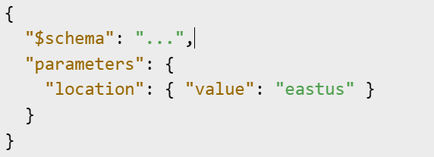
Parameter Files
Purpose: Store environment-specific values separately from templates.
Format: JSON for ARM, .parameters.json for Bicep.
Benefits:
Reusability across environments.
Cleaner separation of code and configuration.
Example:

Slide 5
Linked IR Tokens
Integration Runtime (IR) in Azure Data Factory or Synapse.
Linked IR Tokens:
Allow secure cross-region/cross-subscription data movement.
Require token-based authentication.
Best Practice:
Store tokens in Azure Key Vault.
Use Managed Identity where possible.

Slide 6
Build → Release Pipeline
Build Stage:
Validate templates.
Lint Bicep files.
Package artefacts.
Release Stage:
Deploy to test environment.
Run smoke tests.
Approval gate for production.
Tools: Azure DevOps Pipelines, GitHub Actions.

Slide 7
Smoke Test
Purpose: Quick validation of core functionality after deployment.
Examples:
API responds to requests.
Data pipeline runs successfully.
Automation: Include as part of CI/CD post-deployment steps

Slide 8
Back-out Plan
Purpose: Safely revert changes in case of issues.
Methods:
Redeploy previous stable template.
Rollback using deployment history in Azure.
Best Practice:
Always keep last known good artefacts.
Document and test rollback procedures.

